Slide 1
DeepLab V3

Slide 2
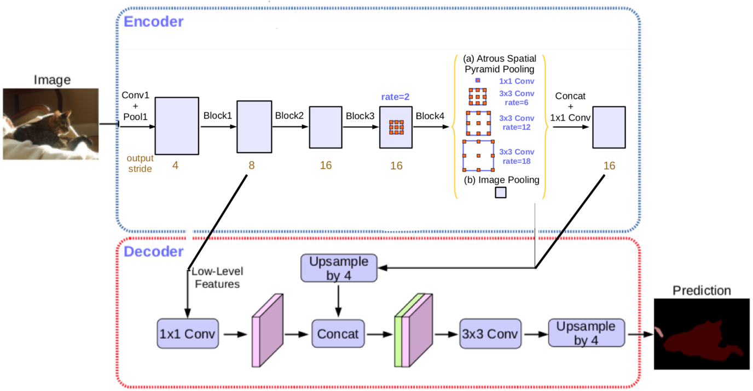
DeepLab V3

Slide 3
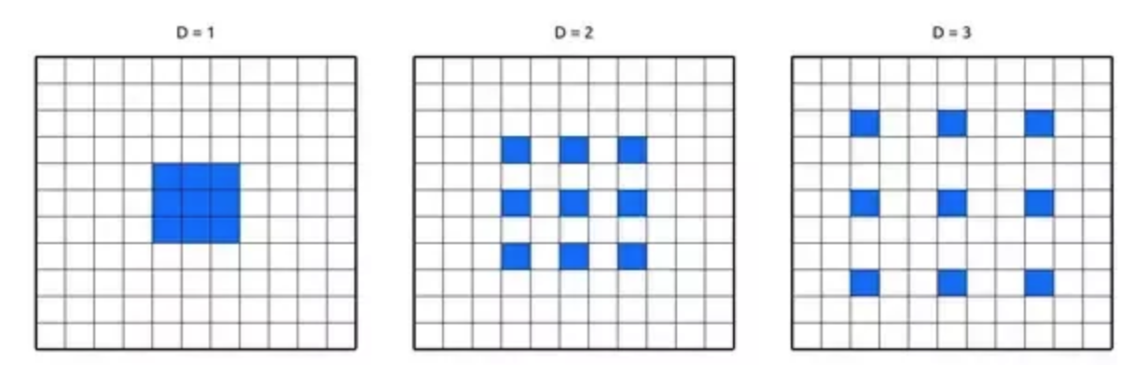
Atrous Convolution

Slide 4
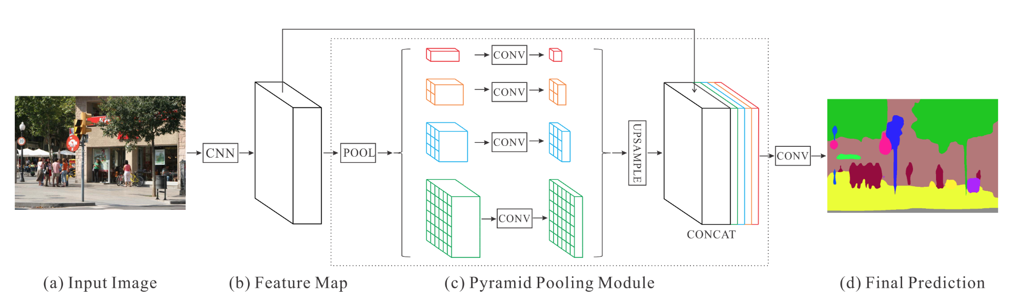
Spatial Pyramid Pooling

Slide 5
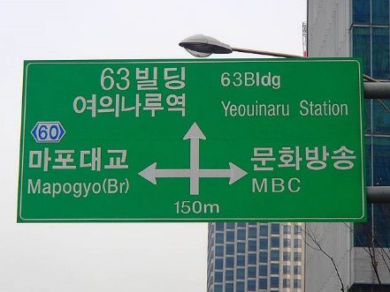
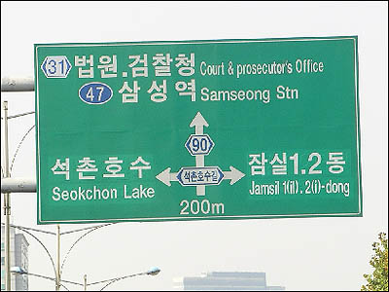


Spatial Pyramid Pooling

Slide 6
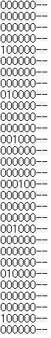
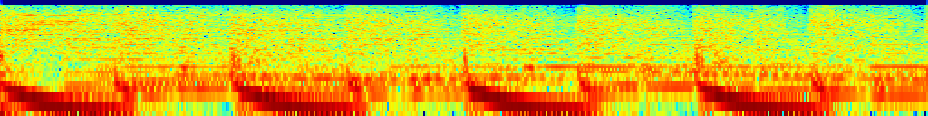
SDVX Convoultion

Slide 7
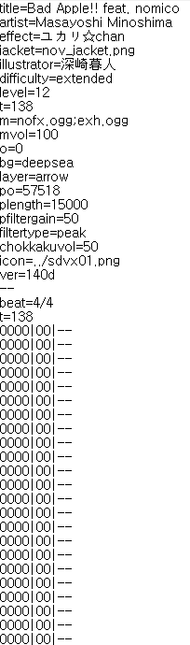

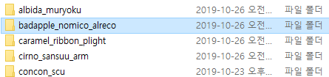
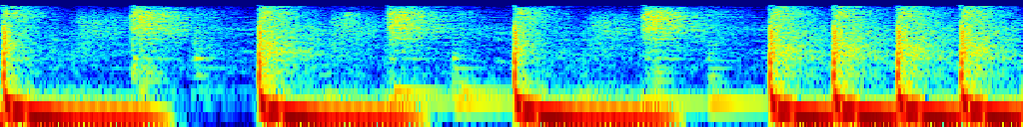
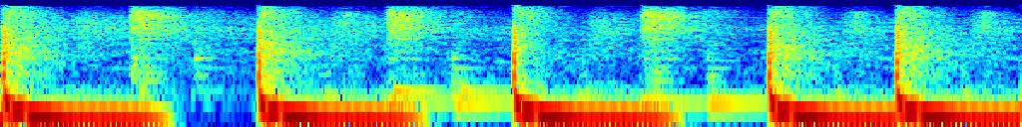
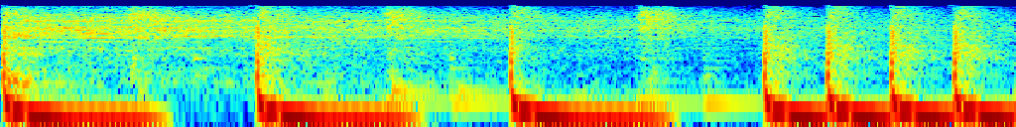
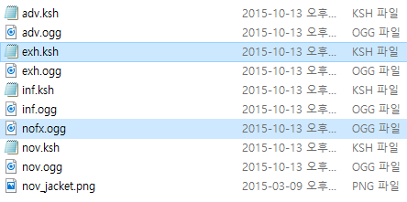
SDVX Convoultion - DataSet
Input, 128 * 1024
Target, 8 * 64
Train set - 31215
Val set - 1972

Slide 8

SDVX Convoultion - model
8 * 64
output
128*1024
Song cut image
11 * 8 * 64
(Class * W * H )
Resnet101
Output Channel 1024 Featrue
Reshape (-1, Class_num,512)

Slide 9
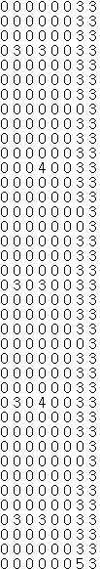
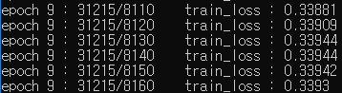
SDVX Convoultion
1줄에 8칸
1~6번째 칸은 버튼, Class 0,1,2만 나올 수 있음
7번째, 8번째 칸은 노브 Class 3~11까지만 나올 수 있음
Class
1 – 버튼
2 – 버튼 오래누름
3 – nove 아무것도 없음
4~11 – nove 위치

Slide 10
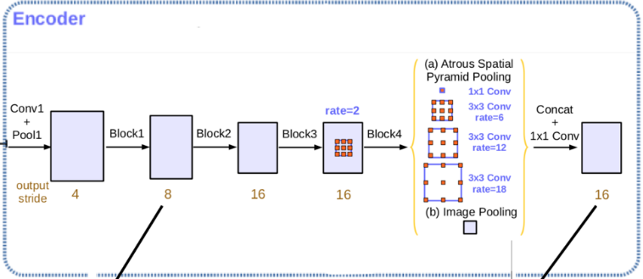
SDVX Convoultion - model
8 * 64
output
128*1024
Song cut image
3 * 8 * 64
(Class * W * H )
Note_model
Reshape (-1, Class_num,512)
Reshape (-1, Class_num,512)
Nove_model
8 * 8 * 64
(Class * W * H )

Slide 11
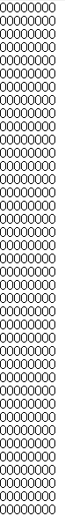

SDVX Convoultion

Slide 12
SDVX Convoultion - model
128*1024
Song cut image
8 * 64
output
3 * 6 * 64
(Class * W * H )
Reshape (-1, Class_num,384)
model
SoftMax ->
Tensor(512)
Reshape (-1, Class_num,128)
8 * 2 * 64
(Class * W * H )
이전 노드들의 정보
LSTM? RNN?

